Slide 1


Charge Injection System (CIS) Update
Katie Hughes, Dawit Belayneh
The University of Chicago
April 11, 2022

Slide 2
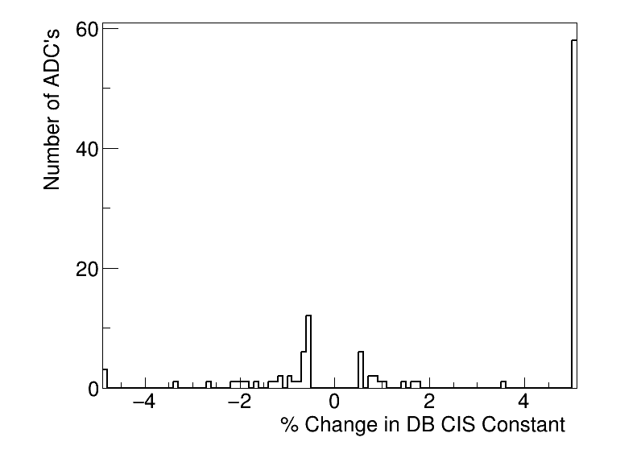
Summary
CIS runs from Mar. 1 - Apr. 1
Will update database after this meeting
110 channels in update
67 good
61 with >5% change
9 masked
34 affected
Notes:
Channels in update is much larger than usual (~125)

Slide 3
Unusually High # of High Deviation Channels
61 channels in the update have >|5%| change:
45 come from demonstrator LBA_m14 (around 20-40% change)
12 come from EBC_m43_ch36-41 (All around 50% change! These channels were at half gain levels during the last CIS update, but have now returned to normal levels…)
Remaining 4 channels are already far from detector average, and have deviations around 5-10% (normal)

Slide 4
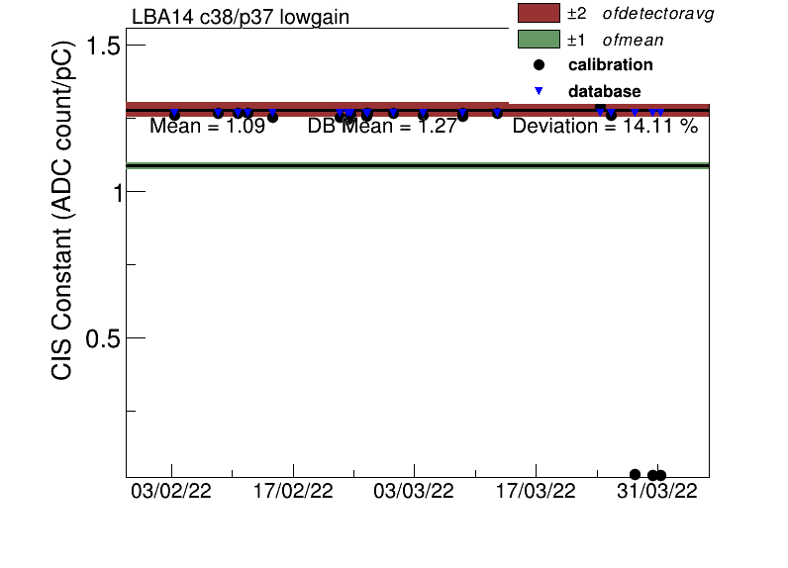
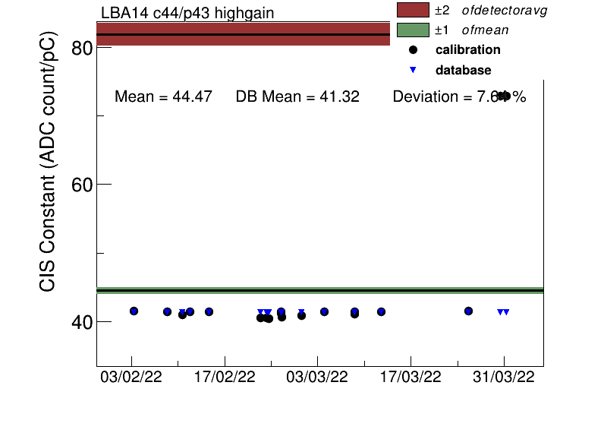
High Deviation Channels (LBA14)
LG drop in value, HG rises in value.
Do I reset CIS constant to most recent value? (only 2-3 runs at this level)

Slide 5
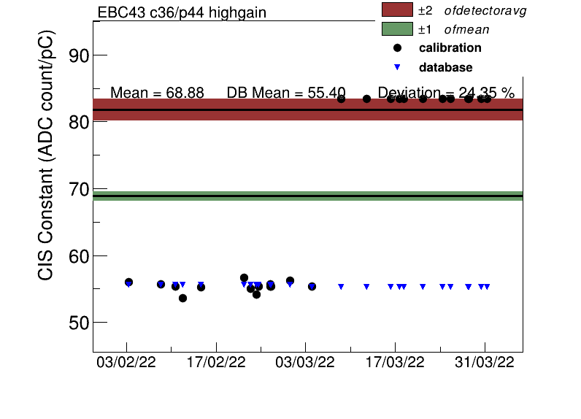
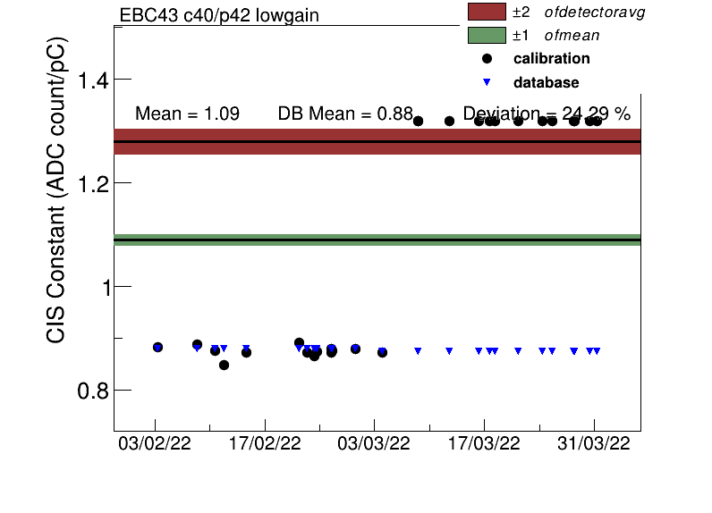
High Deviation Channels (EBC_m43_ch36-41)
New CIS constant reflects most recent value

Slide 6
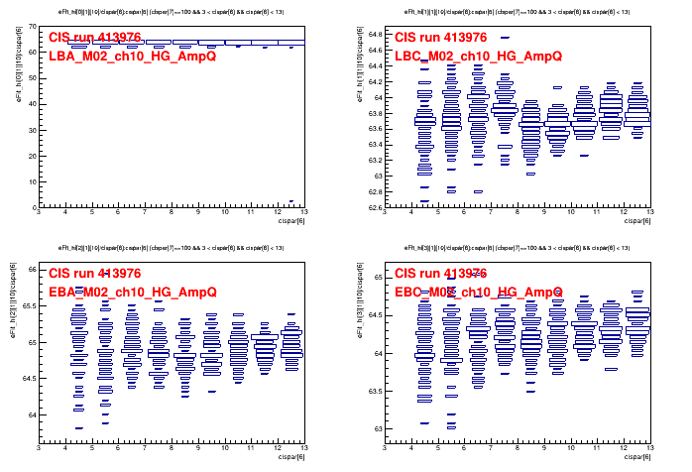
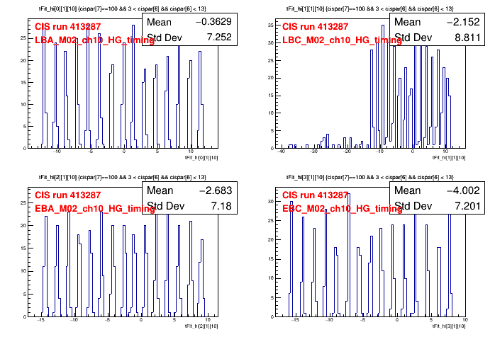
Run Selection
413287: LBC has bad timing
413976: LBA has bad amplitude/charge ratio
Run list used: 413579 413594 414257 414464 414513 414763 415169 415434 415531 415564 415914 416099

Slide 7
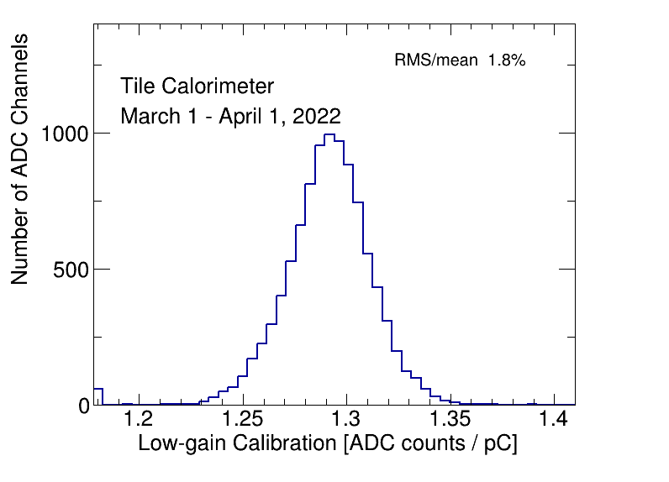
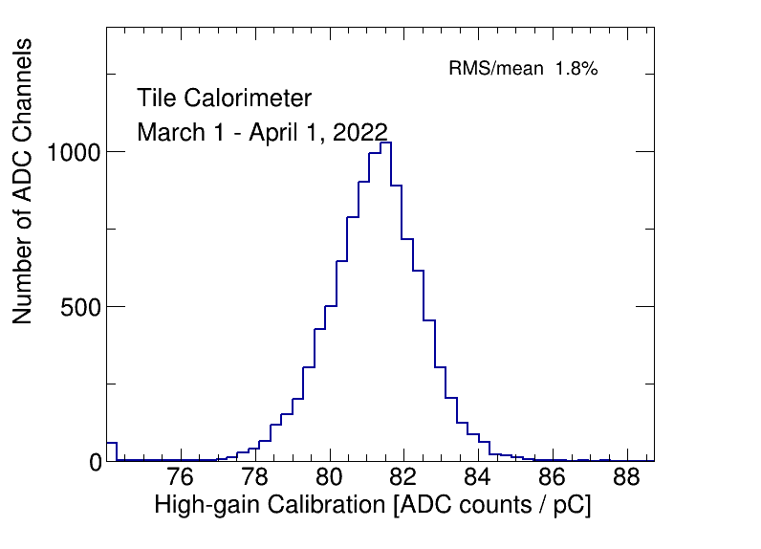
CIS constant distributions

Slide 8
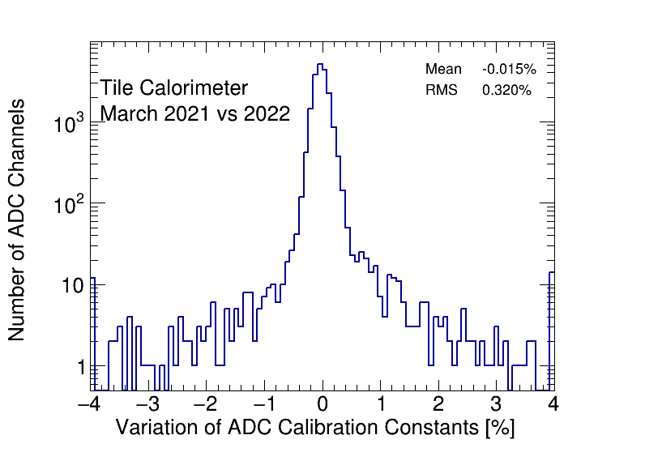
CIS constant stability

Slide 9
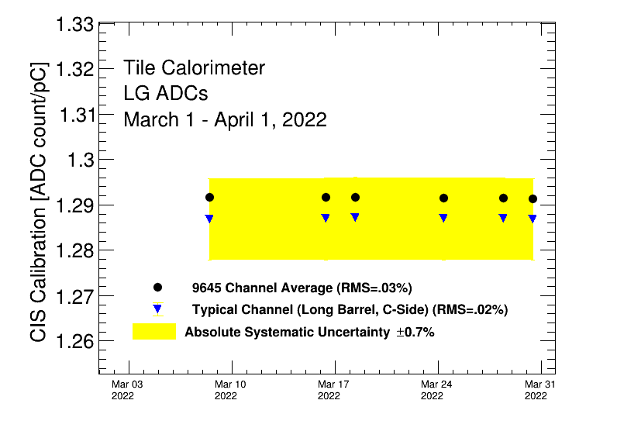
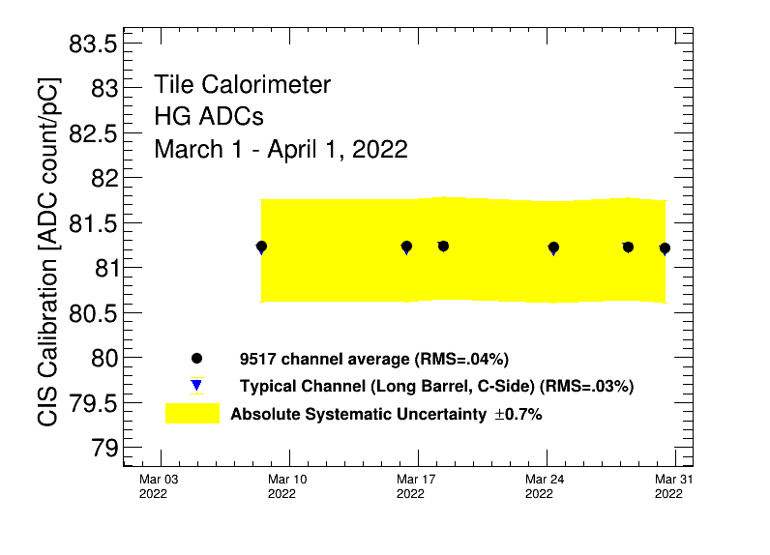
CIS constant stability

Slide 10
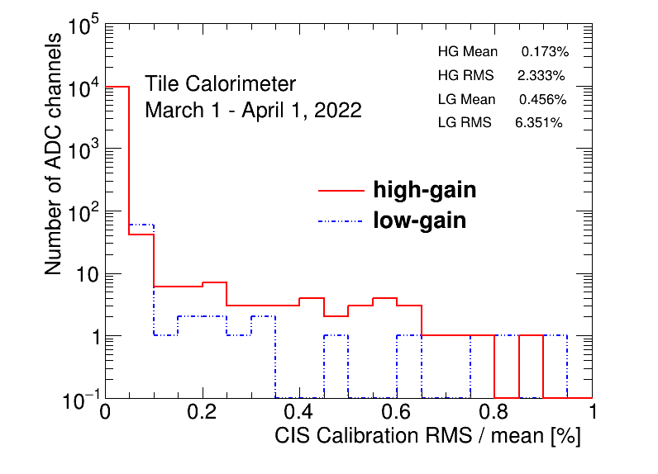
CIS constant RMS/mean

Slide 11
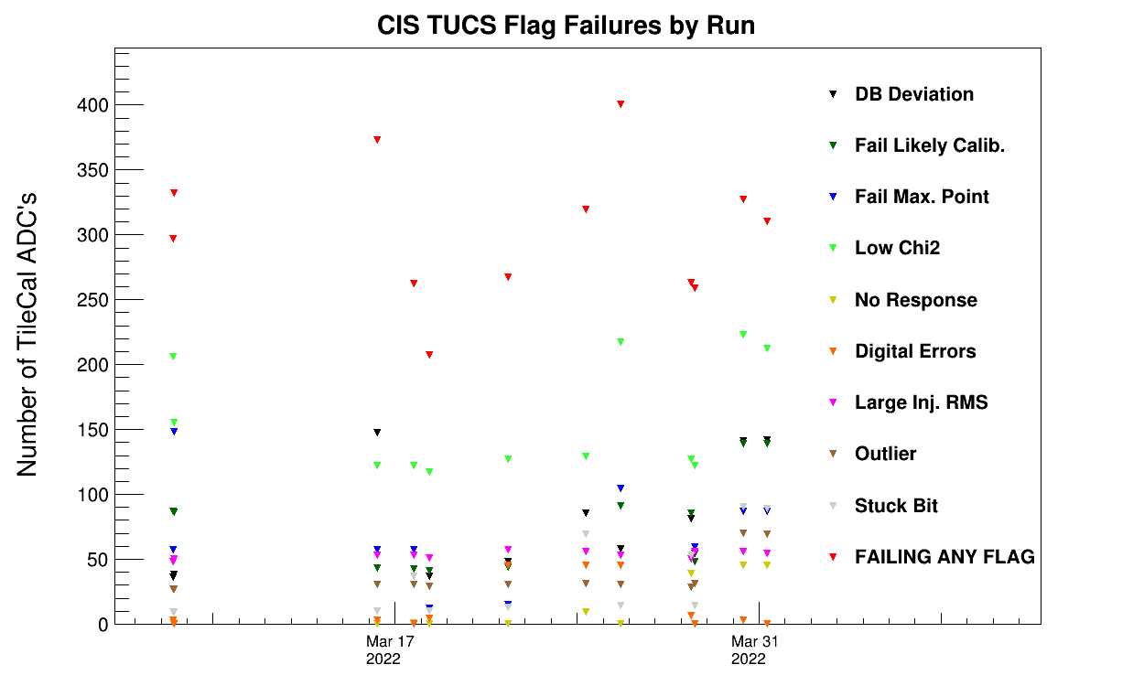
CIS TUCS Quality Flags

Slide 12
Interesting channel behaviour

Slide 13
Channels Far from Detector Avg
Highgain (Avg should be 81)
EBA_m06_c20_highgain: 74.59
EBA_m39_c31_highgain: 74.90
EBA_m42_c30_highgain: 74.70
EBA_m50_c31_highgain: 70.37
EBC_m16_c39_highgain: 74.51
EBC_m18_c36_highgain: 28.68
EBC_m23_c36_highgain: 68.76
EBC_m37_c40_highgain: 73.59
LBA_m62_c26_highgain: 15.28
LBC_m41_c25_highgain: 47.11
LBC_m52_c18_highgain: 94.97
Lowgain (Avg should be 1.29)
EBA_m07_c31_lowgain: 0.98
EBC_m18_c04_lowgain: 0.79
EBC_m23_c31_lowgain: 1.01
EBC_m26_c01_lowgain: 0.17
LBC_m23_c20_lowgain: 1.60
LBC_m47_c35_lowgain: 0.97
DEFAULT

Slide 14
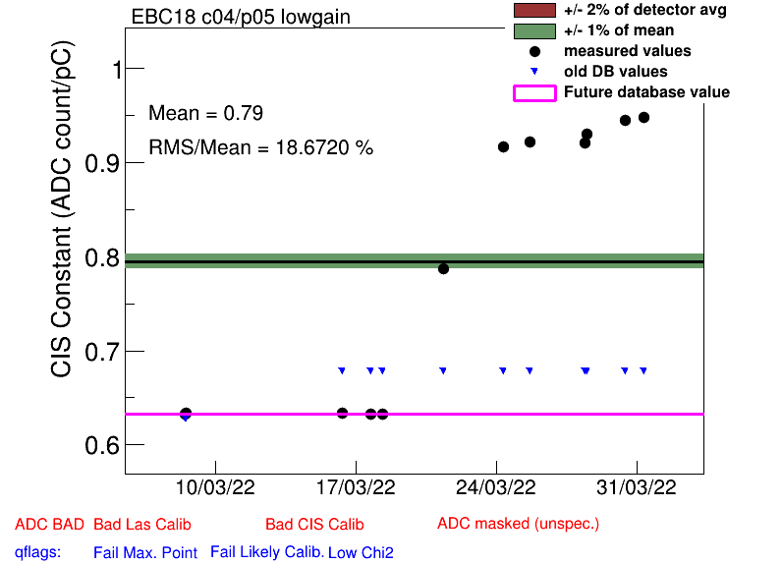
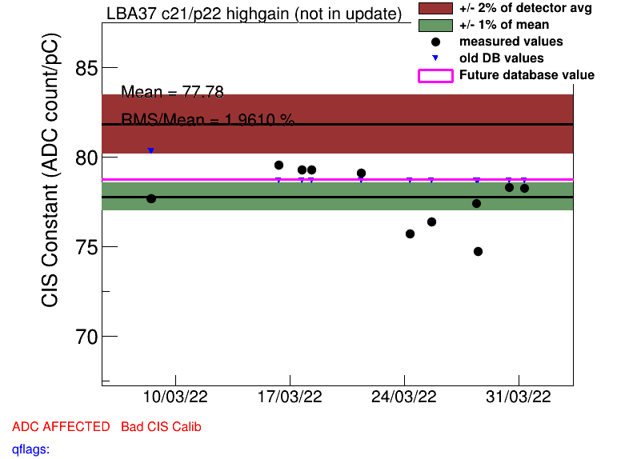
Some High Scatter Channels
EBC_m18_c04_lowgain
EBC_m56_c41_lowgain
LBA_m37_c21_highgain
LBA_m45_c06_highgain
LBA_m62_c26_highgain
LBC_m10_c37_highgain
LBC_m13_c15
LBC_m16_c29_highgain
LBC_m23_c20_lowgain

Slide 15
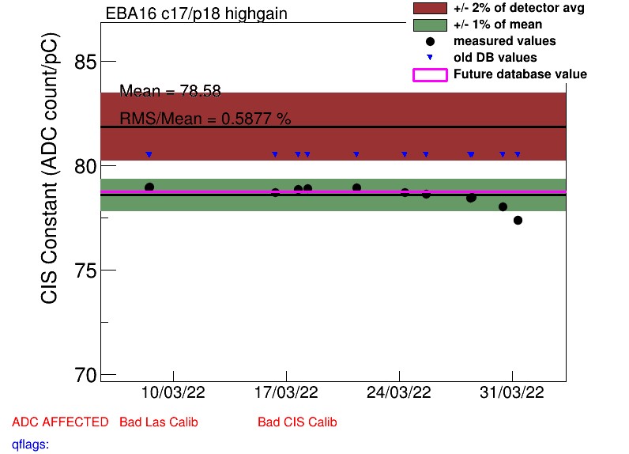
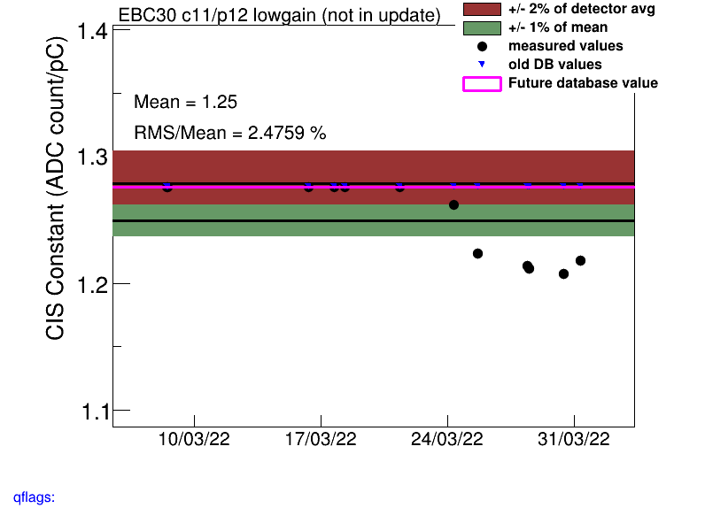
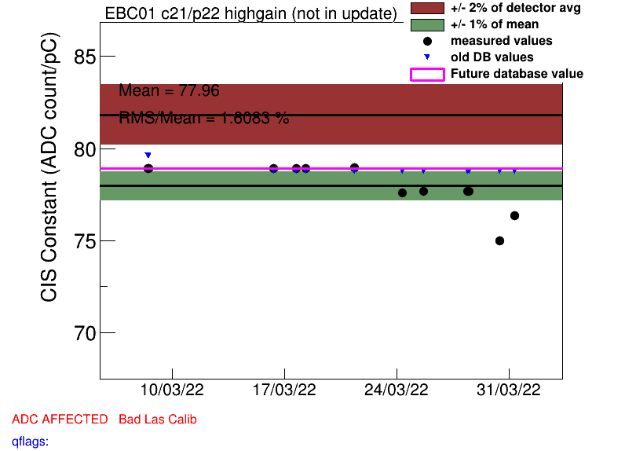
Drifting Channels
EBA_m16_c17_highgain
EBA_m42_c30_highgain
EBC_m01_c21_highgain
EBC_m30_c11
LBA_m51_c12_highgain
LBC_m19_c22_lowgain

Slide 16
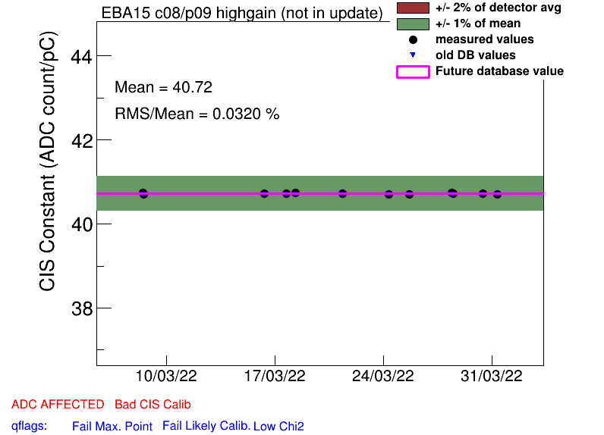
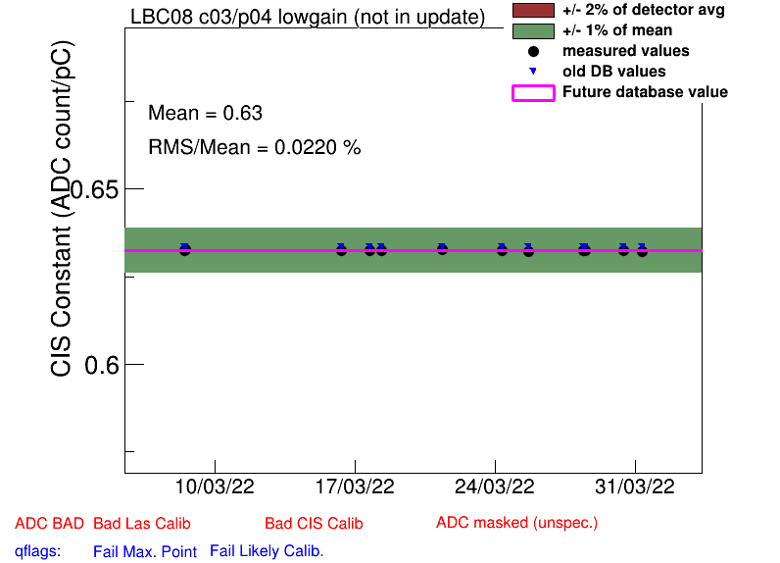
Half Gain Channels
EBA_m15_c08_highgain
EBA_m16_c00_highgain
EBA_m36_c15_highgain
EBA_m48_c31_lowgain
EBA_m64_c03_highgain
EBC_m09_c40_highgain
EBC_m18_c04_lowgain
EBC_m21_c36_lowgain
LBA_m37_c19_highgain
LBC_m08_c03_lowgain
(same as last CIS update)

Slide 17
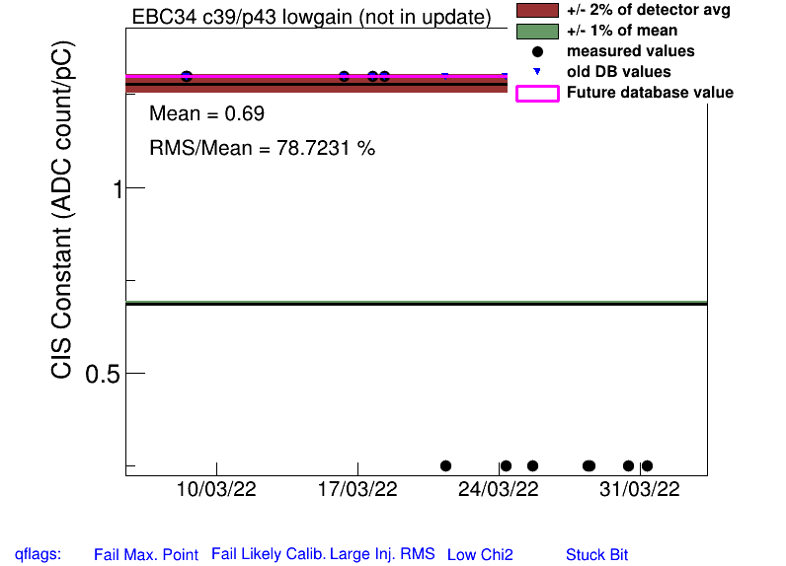
Half Gain “Switching”
EBC_m43_ch36-41: was at half gain last month, now normal values
EBC_m34_c39-41_lowgain: was normal at the beginning of March, now LOWER than half gain (~0.25)

Slide 18
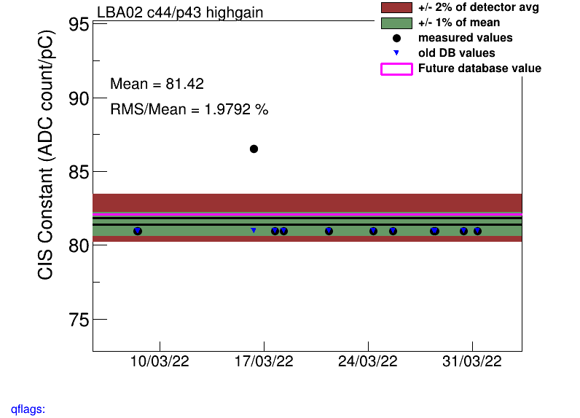
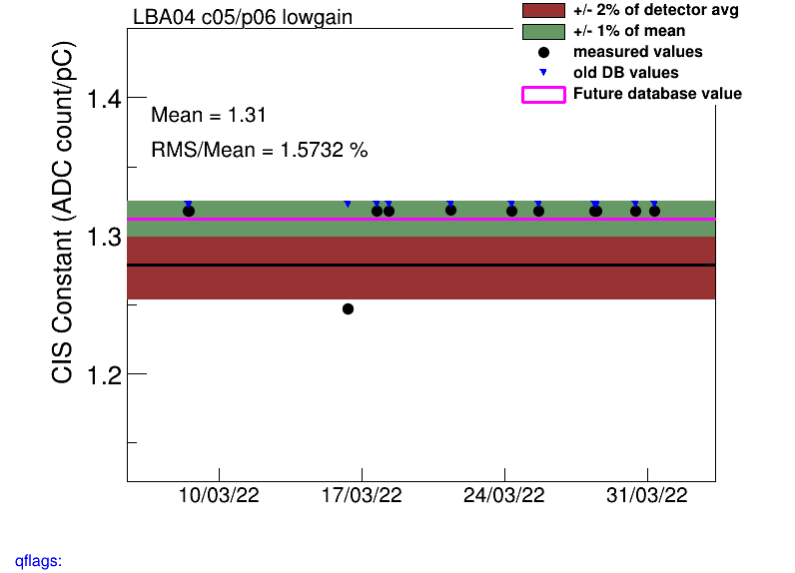
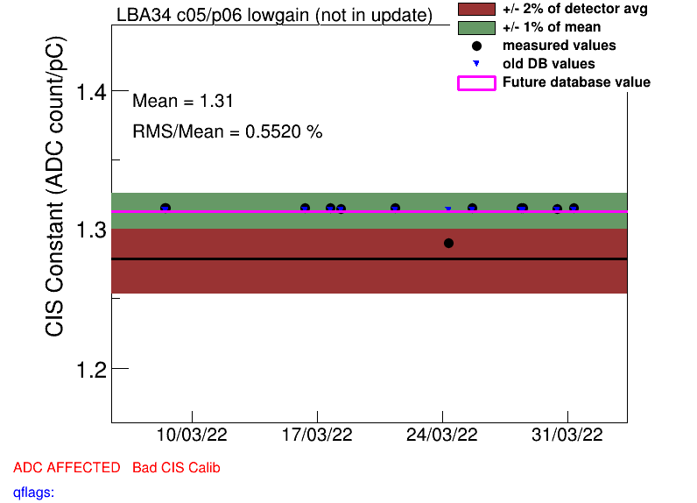
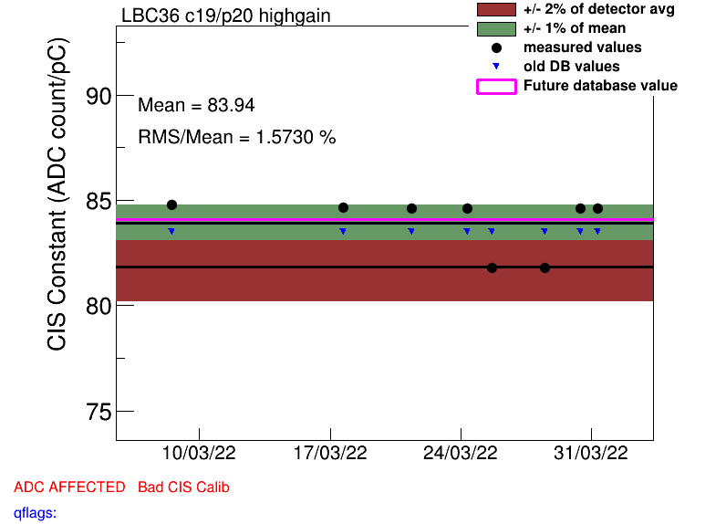
Single run outliers
LBA02 (414257, recalibrated)
LBA04 (414257, recalibrated)
LBA34_lowgain (415169, recalibrated)
LBC_m36_highgain (415434 + 415531, flagged as BadCIS)

Slide 19
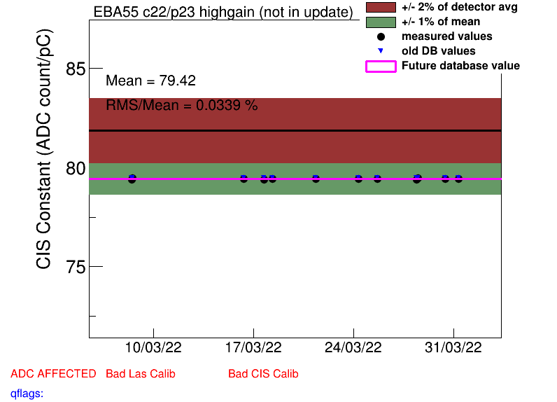
COOL Flag Updates
Remove BadCIS (75)
EBA_m19_c41_highgain
EBA_m48_c05_lowgain
EBA_m55_c22_highgain
EBC_m22_c16_lowgain
EBC_m43_36-41
LBA_m03_c17_lowgain
LBA_m04_c44_highgain
LBA_m04_c44_lowgain
LBA_m06_c38_lowgain
LBA_m34_many_lowgain
LBA_m52_c01_lowgain
LBC_m16_c41_highgain
LBC_m36_c03_lowgain
LBC_m52_c34_highgain
LBC_m63_many
Add BadCIS (7)
EBC_m01_c21_highgain
EBC_m20_c10_lowgain
EBC_m30_c11_highgain
EBC_m30_c11_lowgain
EBC_m34_c39_lowgain
EBC_m34_c40_lowgain
EBC_m34_c41_lowgain

Slide 20
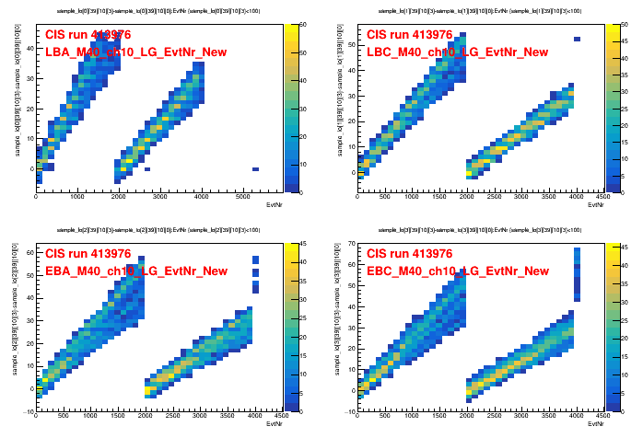
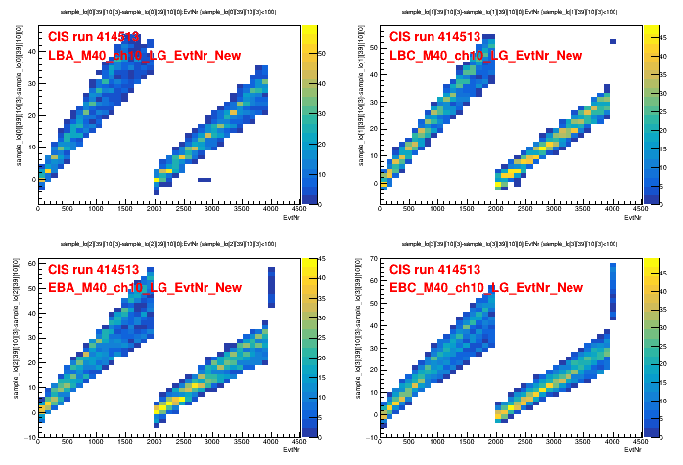
Missing Pulses
LBA is missing pulses in CIS runs 413976, 414513, 414763, and 415564
This does not seem to affect calculations of CIS constants for these runs.
Plot:h2000->Draw("sample_lo[0][40][10][3]-sample_lo[0][40][10][0]:EvtNr","sample_lo[0][40][10][3]<100","COLZ"), and look for points at 0 in unexpected places (thank you Sasha for the help!)

Slide 21
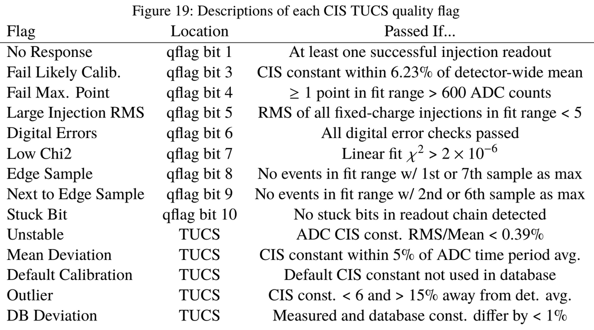

Slide 22
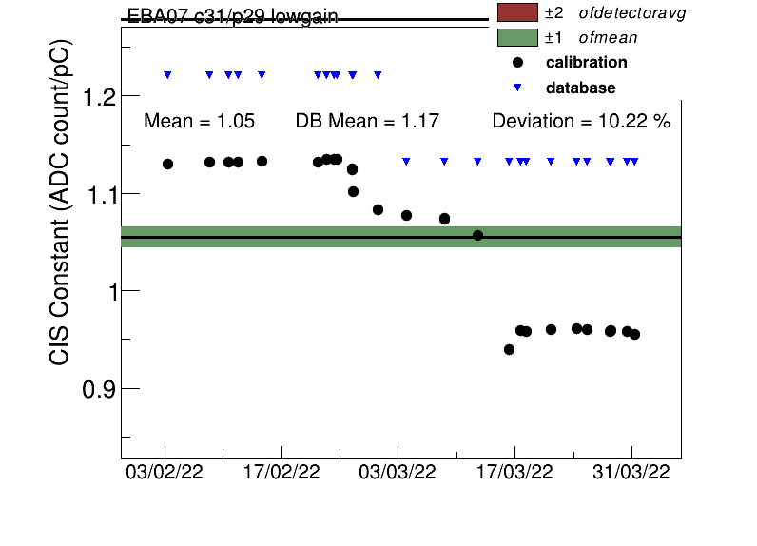
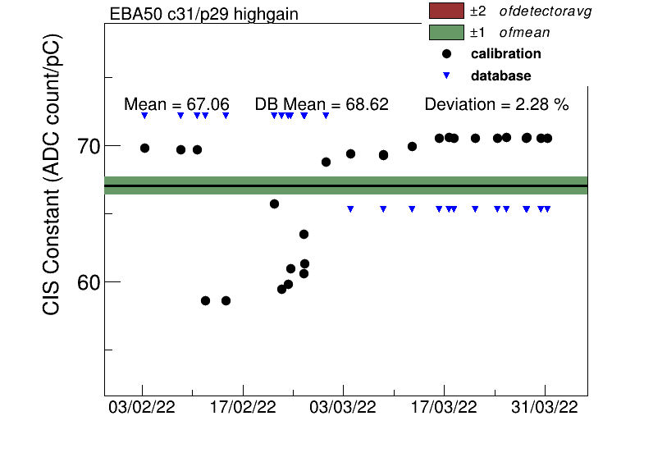
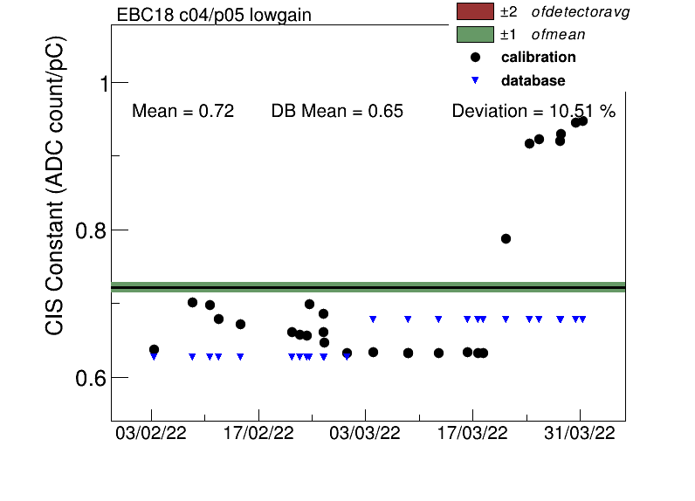
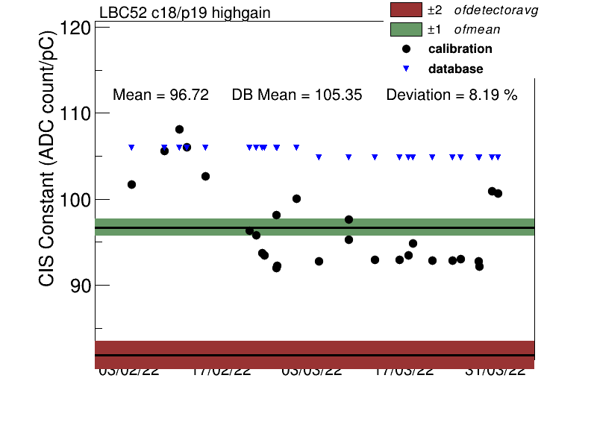
High Deviation Channels (others)

